Slide 1

APLC
Adidas tech sportS: “PROJECT NAME”

Slide 2

Team members
Jorge serrano ibáñez
1º ingeniería informática
Tomás Pelayo benedet
1º ingeniería informática
Jorge romanos pajares
1º ingeniería informática

Slide 3
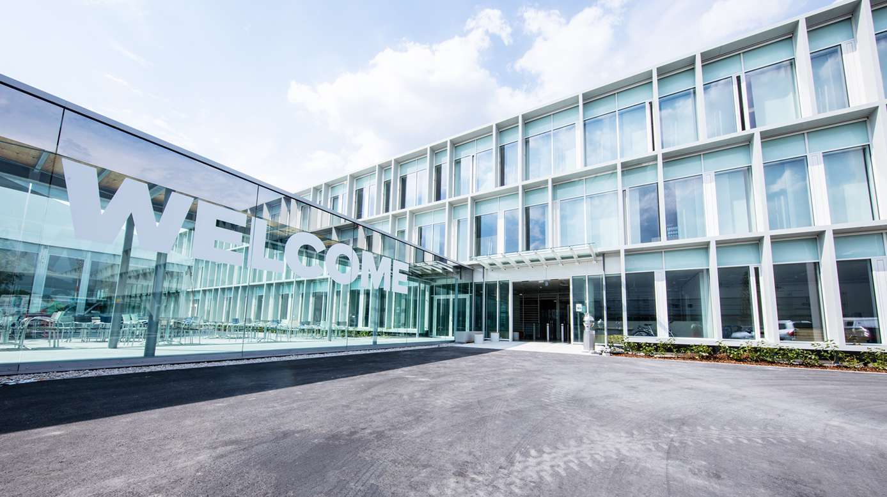
AGENDA
THE STORY
FOCUS
VALUE
DEMO
Q&A

Slide 4
THE STORY - MAKE IT RELATABLE
Introduction – What is the setting

Slide 5
THE STORY - MAKE IT RELATABLE
2. Rising Action – What is happening

Slide 6
THE STORY - MAKE IT RELATABLE
3. Turning point – Where does it become actionable

Slide 7
THE STORY - MAKE IT RELATABLE
4. Falling Action – What is the outcome

Slide 8
THE STORY - MAKE IT RELATABLE
5. Resolution – How it ends

Slide 9
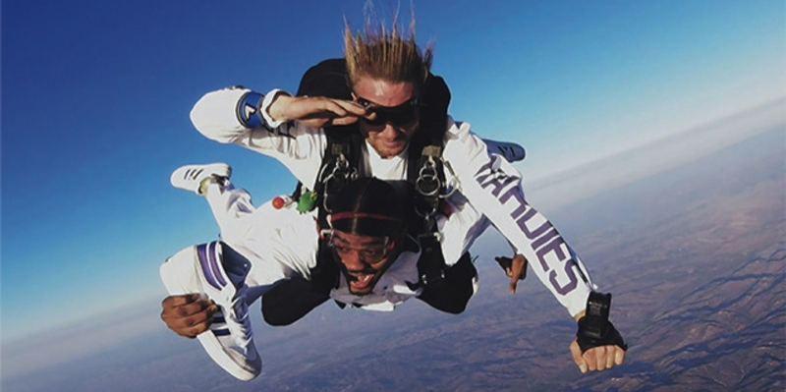
THE STORY

Slide 10
FOCUS
BE CONCISE
WHAT DID YOU DO?
WHAT IS THE VALUE?
HOW IS IT DIFFERENT?

Slide 11
VALUE
WHY DOES IT MATTER?
WHO DOES IT IMPACT?
WHERE IS THE BUSINESS OPORTUNITY?

Slide 12
MAKE IT REAL
DEMO

Slide 13
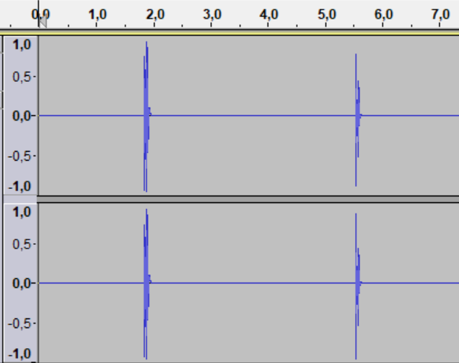
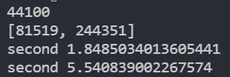

Slide 14
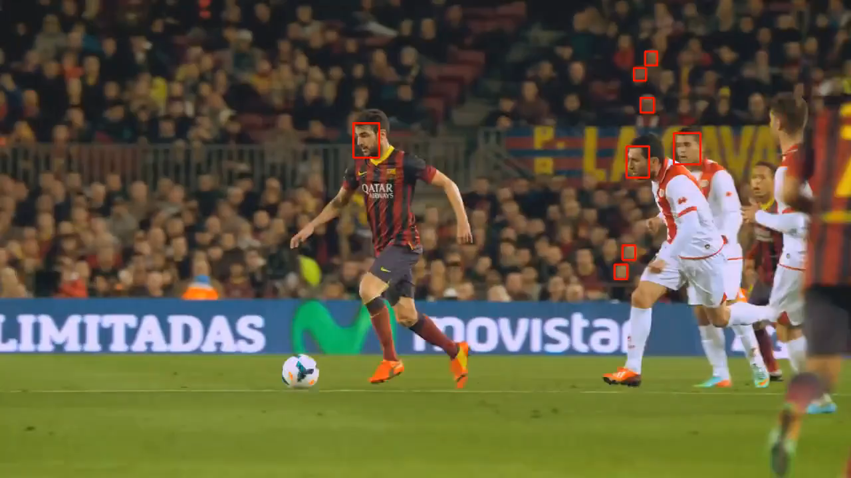

Slide 15
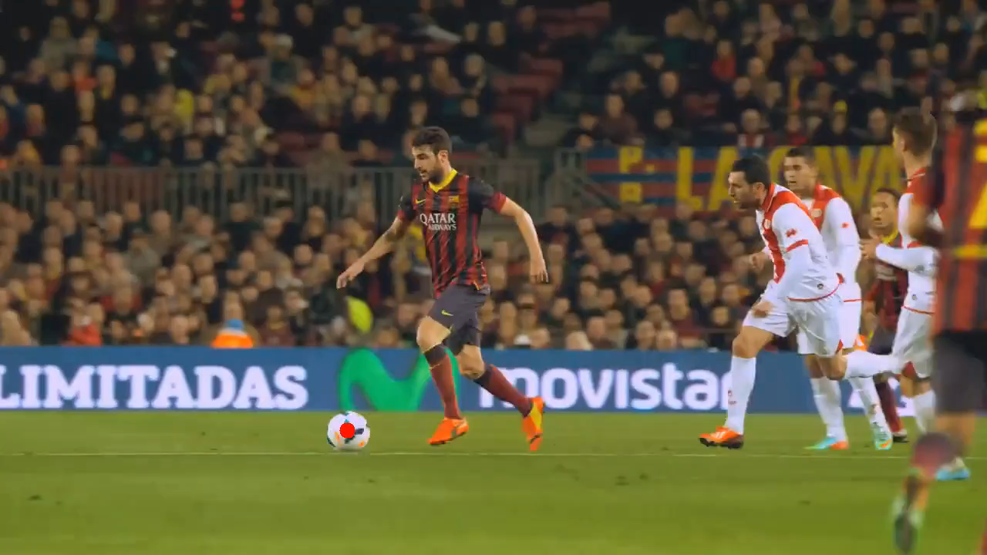

Slide 16

Q
A
&

Slide 17
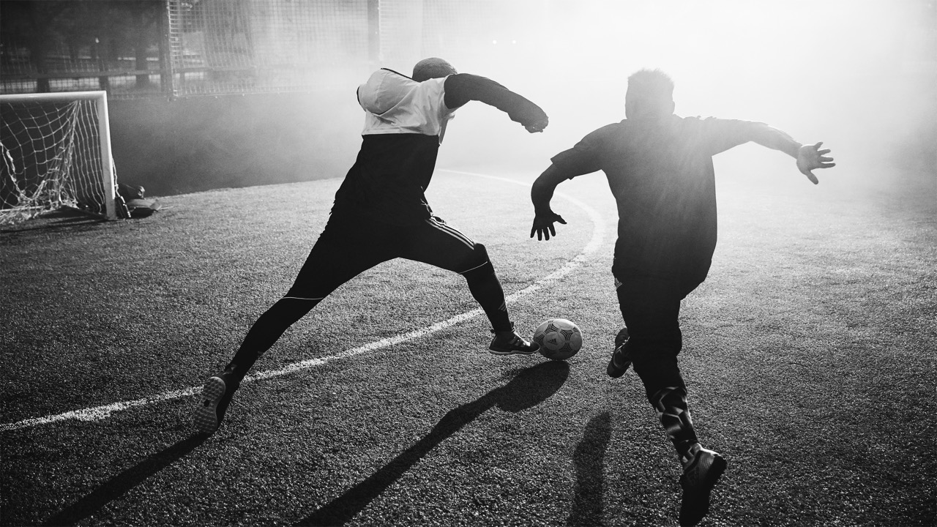
THANK YOU!

Slide 18

remember
Get something working (PoC)
Use all your technical skills
Try to create a real business impact
To prepare a nice presentation (recorded demo)

Slide 19
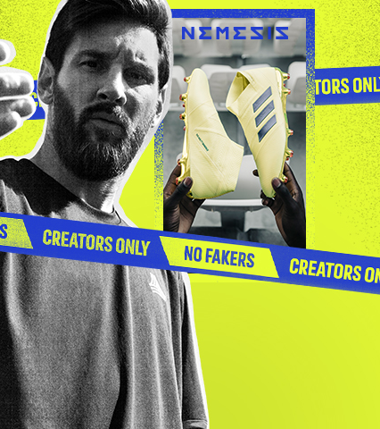
ShoW
A STORY THAT OTHERS CAN REMEMBER
FIND REAL TANGIBLE VALUE
KEEP IT FOCUSED
MAKE THE EXPERIENCE LIVE

Slide 20

Judging criteria
TECHNICAL IMPLEMENTATION AND COLLABORATION FOR THE USE OF HETEROGENEOUS TECHNOLOGIES: 25%
CONFIDENCE TO ADD VALUE AND CREATE A REAL-LIFE BUSINESS IMPACT: 25%
EFFECTIVE COMMUNICATION AND SUMMARY OF RESULTS: 25%
INNOVATION AND CREATIVITY: 25%

Slide 21

rules
Only genuine work done along this hackathon will be evaluated
OPEN SOURCE by default
The more relevant to the challenge topic the better
All technical skills are welcome
Presentations: 6 + 2 + 2
(6 mins pitch + 2 mins questions +
2 mins switching teams)

